Slide 1
Uranium Working Group Public Meeting
Virginia Beach Convention Center
August 28, 2012
Presentation by the Rick Weeks, Chief Deputy
Department of Environmental Quality

Slide 2
Presentation Overview
Overview of DEQ programs
Details on air and water programs relevant to uranium mining and milling
Review of themes in recent studies
Conceptual regulatory framework

Slide 3
Overview of DEQ programs
Develops regulations with final authority resting with three citizen boards:
State Air Pollution Control Board for air quality
State Water Control Board for water quality and water supply
Waste Management Board for solid and hazardous waste
Notes:
Implement programs to protect Virginia’s air, water & land
Enhance the environment

Slide 4
Overview of DEQ programs
Develops regulations (cont.)
Public participation requirements
NOIRA, public comment and public meeting
Regulatory Advisory Panel
Approval of a draft regulation by the Citizen Board
Public comment and hearings
Public comment at the Citizen Board meeting
Final approval by the Citizen Board

Slide 5
Overview of DEQ programs
Environmental permitting
Ensure compliance with permits & regulations
Conduct environmental monitoring and assessment
Respond to environmental incidents
Provide environmental information, public participation & technical assistance

Slide 6
More details on DEQ’s existing authority relevant to uranium mining and milling

Slide 7
DEQ air quality monitoring
Extensive Air Quality Monitoring Program
Criteria Pollutants e.g., Ozone
Hazardous Air Pollutants
Operate three radiation monitors for the federal government
DEQ has extensive experience in performing particulates monitoring – large particles (TSP), coarse particulates (PM10) and fine particulates (PM2.5)
Notes:
DEQ is required to conduct air quality monitoring by both federal and state regulations. The air sampling program is a combined effort of the Air Quality Monitoring Office or AQM, six regional offices, the Alexandria Transportation and Environmental Services, the National Park Service, and the US Department of Agriculture Forest Service.
As a courtesy to two other states, AQM has reviewed 2 separate monitoring plans for other uranium mines in the US. The radiation analyses are performed on particulate samples.
Recently AQM has met with UVA and Virginia Uranium to discuss air monitoring.

Slide 8
DEQ air quality monitoring
Conducted air quality monitoring in the area of Chatham, VA
In 1999 performed ozone precursor sampling in the Chatham area
In 2004 performed PM10 monitoring in the Chatham area. The PM10 results were well below the ambient air standard for PM10. In addition to the PM10, AQM also performed VOC and ozone precursor sampling

Slide 9
Air permitting
Radioactivity requirements for air emissions is regulated by EPA under NESHAP (National Emissions Standards for Hazardous Air Pollutants)
Virginia Air Pollution Control Law Article 6 will require permits for operations such as crushing, screening, haul roads, and engine emissions
Notes:
Air quality permits are issued to industries and facilities that emit regulated pollutants to ensure that these emissions do not harm public health or cause significant deterioration in areas that presently have clean air. The permit also ensures that facilities make adequate provisions to control their emissions.
NESHAPS radioactivity requirements have not been delegated to Virginia

Slide 10
Water Quality and Quantity
State Waters: All waters on and below the surface
Groundwater: All waters below the surface
Surface Waters: All other waters including steams, rivers, lakes, estuaries and wetlands

Slide 11
DEQ groundwater monitoring
Statewide water level monitoring program
Good coverage in GW management areas
Limited coverage outside management areas
No ambient GW chemistry monitoring since 1990
No ambient GW monitoring for radiation

Slide 12
Water quality standards
Water Quality Standards consist of the following components:
Designated Uses
Water Quality Criteria
Anti-Degradation Policy

Slide 13
Water quality standards designated uses
All surface waters are designated for and have criteria to protect for:
Recreational uses including swimming
Support of an indigenous population of aquatic life
Production of an edible and marketable natural resource

Slide 14
Water quality standards designated uses
Some surface waters are designated for public water supply and have additional criteria to protect water supplies
Several segments of the Banister River and Cherrystone Creek upstream from Chatham’s raw water intake
Lake Gaston and the John Kerr Reservoir in Virginia

Slide 15
DEQ water quality monitoring
DEQ has one of the largest ambient water quality trace elements monitoring programs in the nation
DEQ developed ultra low level sampling and analytical methods for trace elements
Since 1997 DEQ has analyzed 4,463 samples at 1,801 individual sites for trace elements
15

Slide 16
Water quality monitoring
The following elements, both dissolved and total, are monitored in the water column:
aluminum, antimony, arsenic, barium, beryllium, cadmium, chromium, copper, lead, magnesium, manganese, mercury, nickel, selenium, silver, thallium, zinc

Slide 17
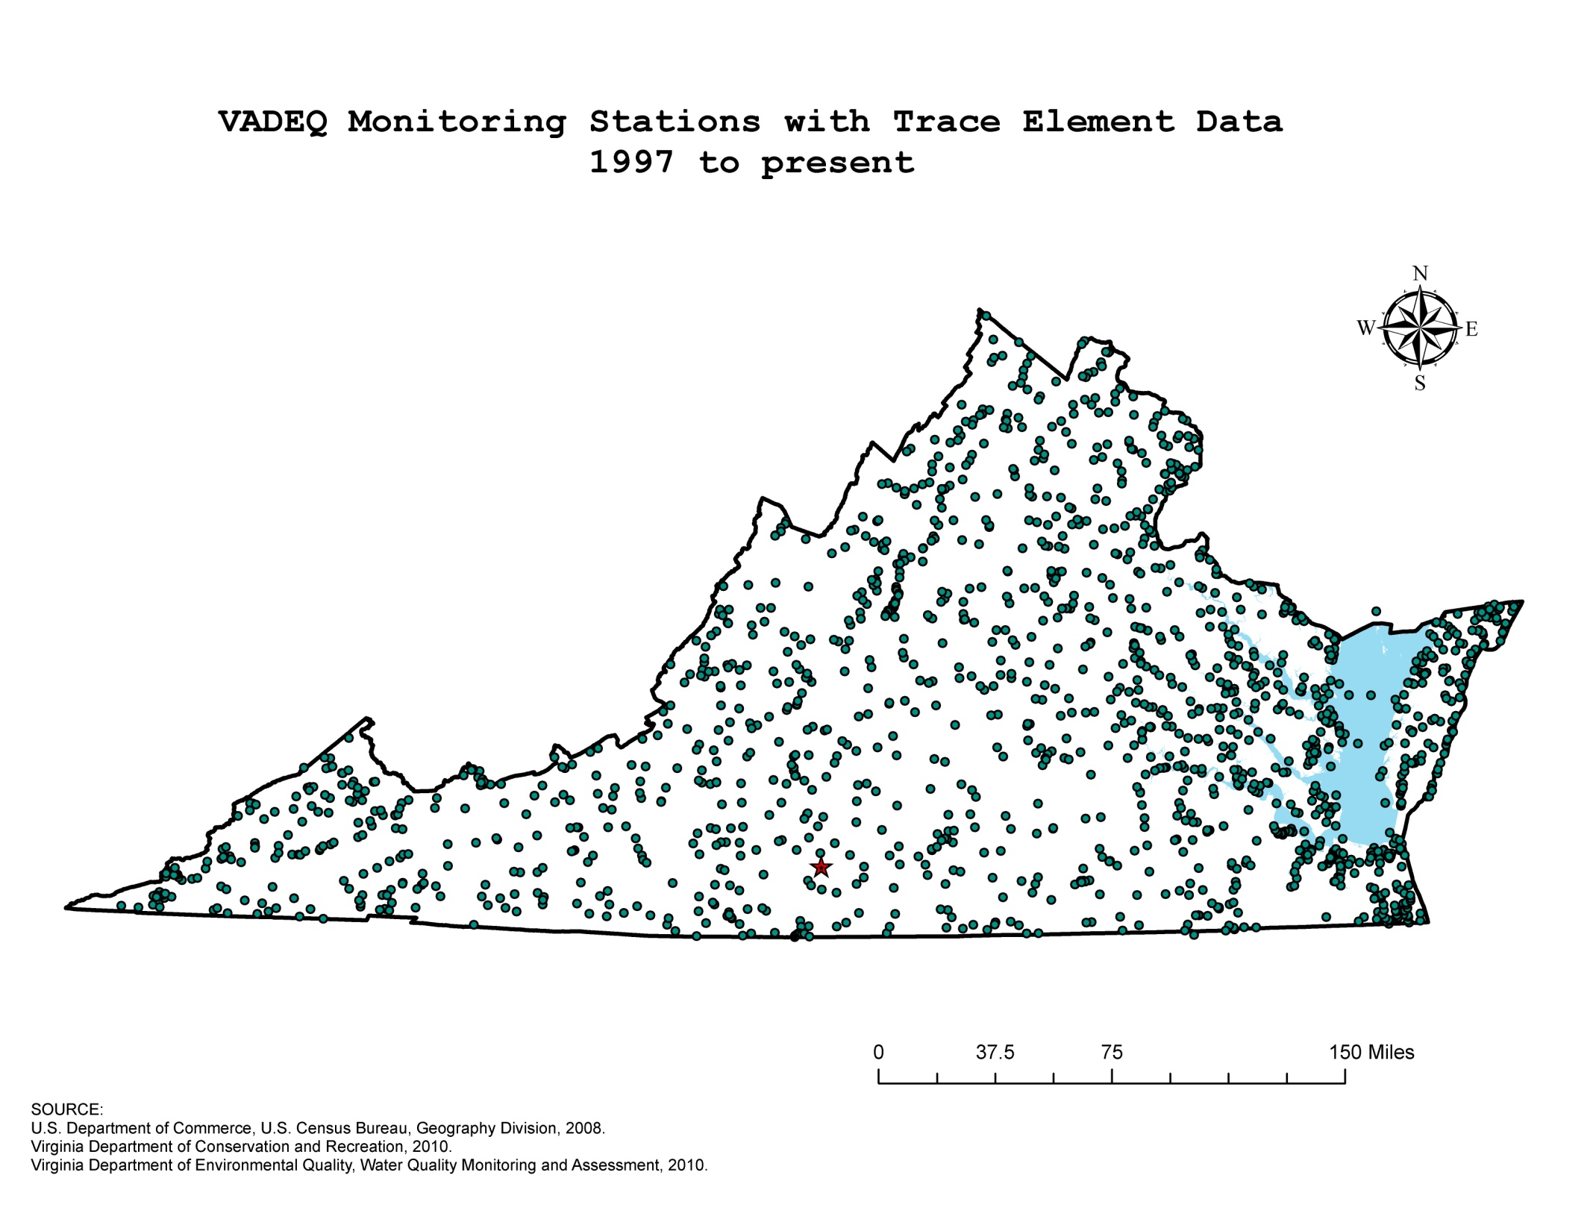

Slide 18
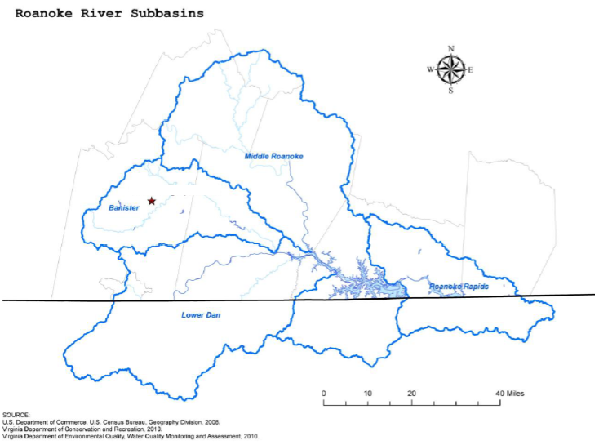

Slide 19
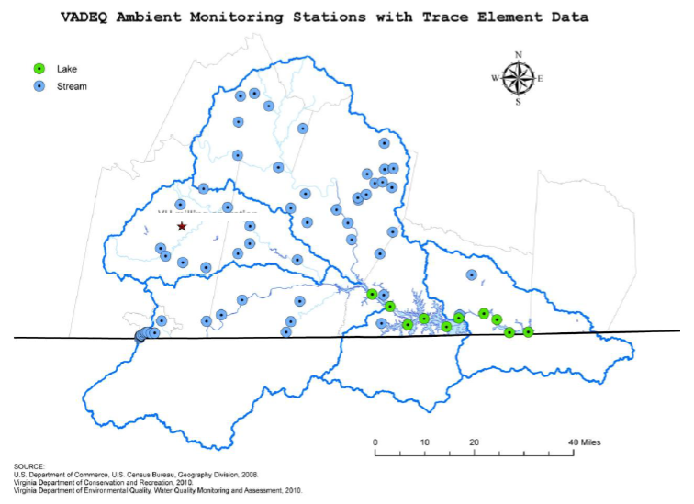
Notes:
Within the four Roanoke subbasins we have collected trace element data at 65 ambient stream sites and 10 lake sites.
We have requested a quote for the additional cost of adding Uranium to our target analyte list of trace elements.

Slide 20
Water quality criteria 9 VAC 25-260
Parameter | Aquatic Life Freshwater |  | Human Health
 | Acute | Chronic | Public Water Supply Designated Rivers | All Other Surface Waters
Gross Alpha Particle Activity |  |  | 15 pCi/l
Beta Particle & Photon Activity |  |  | 4 mrem/yr
Combined Radium 226 & 228 |  |  | 5 pCi/l
Uranium |  |  | 30 ug/l
Zinc | 120 ug/l | 120 ug/l | 7,400 ug/l | 26,000 ug/l
Notes:
Water Quality Criteria are stream standards established by Virginia and approved by EPA to protect Water Quality. Reexamined every 3 years.
No radionuclide criteria outside of public water supply
Radionuclide criteria calculated to protect human health from toxic effects through drinking water and fish consumption (lifetime exposure).
Aquatic life acute and chronic criteria for metals including Zn.
The 120 ug/l Zinc acute and chronic criteria based upon hardness of 100 mg/l. Depending on hardness of the stream an equation is used to calculate the criteria. Water Effects Ratio (WER) may also be used to adjust criteria.
Depending on the characteristics of the mining discharge other Water Quality criteria will be evaluated when determining permit limitations to ensure water quality is protected. For example arsenic, copper, and selenium have been found in discharges from uranium mining.
VPDES Permit would establish effluent limitations to ensure the mining discharge does not cause the stream Water Quality standards to be exceeded.

Slide 21
Groundwater standards for radioactivity 9 VAC 25-280
Constituent | Concentration
Total Radium (Ra-226 &Ra-228) | 5 picoCurie per liter
Radium 226 | 3 picoCurie per liter
Gross Beta Activity* | 50 picoCurie per liter
Gross Alpha Activity (excluding Radon & Uranium) | 15 picoCurie per liter
Tritium | 20,000 picoCurie per liter
Strontium-90 | 8 picoCurie per liter
Manmade Radioactivity – Total Dose Equivalent** | 4 millirems per year
*Used as a screening value only | **Combination of all sources should not exceed total dose equivalent of 4 mrem/year

Slide 22
DEQ water permitting
Virginia Pollutant Discharge Elimination (VPDES) – regulates point source discharges to surface waters
Groundwater Withdrawal - withdrawing >300,000 gallons of water per month within a GW management area
Virginia Water Protection - wetlands and stream protection, and requires a permit for new surface water withdrawals >300,000 gallons of water per month
Notes:
EPA has delegated the NPDES program to DEQ. Under this program DEQ is authorized to permit discharges to surface water from uranium mining activities.
Specific technology based limitations are contained in the Federal Ore Mining and Dressing Point Source Category (40 CFR 440), Subpart C.
VPDES Permit Regulation (9VAC25-31-10) incorporates these technology based effluent limitations.

Slide 23
DEQ water permitting
Public Participation requirements:
All VPDES permits are public noticed with a 30 day comment period
If we receive 25 individual requests:
A hearing and an additional comment period are held
Public comment is received by the Citizen Board
The citizen Board makes the final decision

Slide 24
DEQ water permitting
Point source discharges: water with the potential to have pollutants conveyed by a pipe or ditch to State Waters
Process water: in an industrial setting this is primarily water used in an industrial operation
Industrial stormwater: rainwater run-off from an industrial site
Both are regulated as point sources through VPDES permits

Slide 25
Water permitting – uranium VPDES surface water discharge
Technology Based Limits
Required by Federal Uranium Point Source Requirements (40 CFR 440)
Requirements incorporated into the Virginia VPDES Permit regulation (9VAC25-31-10)
Limits to ensure that there is no reasonable potential to violate Water Quality Standards
Notes:
Federal requirements allow discharges to surface water for uranium mining and milling provided effluent limitations are met.
For new uranium mines any mine drainage (water drained, pumped, or siphoned from a mine) must meet the effluent guidelines. Stormwater associated with the mine is not regulated by these process wastewater requirements however a VPDES permit is required.
For new uranium mills the mill facility is required to design the treatment facility to contain mill process wastewater and stormwater resulting from a 10-year, 24-hour storm event. The regulation allows the mill to discharge the volume of wastewater greater than the annual precipitation contributing surface runoff to the mill treatment facility minus the annual evaporation volume. This discharge must meet effluent guidelines. For rainfall greater 10-year, 24-hour storm event discharges are exempt from the effluent requirements provided facility demonstrates that design requirements are met, the facility takes all reasonable steps to minimize the discharge and notification requirements are met.

Slide 26
Water permitting technology new source limits EPA 40 CFR 440
Effluent Characteristics | Maximum | 30-Day Average
COD | 200 mg/l | 100 mg/l
Zn | 1000 ug/l | 500 ug/l
Ra 226 (dissolved) | 10.0 pCi/l | 3.0 pCi/l
Ra 226 (total) | 30.0 pCi/l | 10.0 pCi/l
Uranium | 4000 ug/l | 2000 ug/l
TSS | 30.0 mg/l | 20.0mg/l
pH | 6.0 - 9.0
Notes:
Note that Zn and Uranium are in ug/l
These values are effluent limitations that the facility must meet prior to the discharge to the stream.

Slide 27
DEQ Compliance and Enforcement
Conducts over 7,000 inspections per year to ensure compliance with permits and regulations
Executes approximately 120 enforcement orders per year
Collects over $2 million in civil charges per year
Collected over $3 million in civil charges in State fiscal year 2012,

Slide 28
Virginia Uranium Studies
The UWG has reviewed recent studies and past reports including:
Chmura
National Academies
Research Triangle Institute
Virginia Beach
Fairfax Water
1984 UTF
Others
Common themes and recommendations are being carefully evaluated

Slide 29
Recent studies – common themes
There should be transparency throughout the permitting, mining and reclamation phases.
An environmental impact analysis prior to the commencement of mining activities is an internationally accepted best management practice.
Engineering design standards must consider the possibility of extreme weather and climate events.
Health and environmental concerns should be evaluated holistically.
Sources: NAS (2011), Chmura (2011)

Slide 30
Recent studies – common themes
Groundwater resources should be protected in accordance with Virginia’s anti-degradation policy for groundwater.
Thorough site characterization supplemented by predictive modeling would be necessary to evaluate the potential risks of environmental impacts.
Waste rock and ore stockpiles must be managed effectively to prevent the release of radiological and non-radiological contaminants.
Sources: UTF (1984), RTI (2011), IAEA (2002)

Slide 31
Recent studies – common themes
A comprehensive and effective community-engaged environmental monitoring program is necessary to assure compliance and foster transparency.
Virginia’s positive water balance conditions and implications for runoff from mine waste, tailings, ore stockpiles must be considered.
Future impacts of mine dewatering on groundwater resources must be considered.
Sources: Chmura (2011), RTI (2011)

Slide 32
Study work plan topics
Overview of existing authority relevant to uranium mining and milling focusing on:
Water quality and air quality protection and monitoring frameworks in Virginia
Frameworks used in other states and countries where uranium mining and milling take place
Virginia’s Water Quality Standards for groundwater and surface waters

Slide 33
Conceptual regulatory framework
The following are concepts that could be included in a conceptual regulatory framework:

Slide 34
Possible regulatory requirements for permit applicants
Comprehensive environmental data (EIA) covering the full lifecycle of the mining and milling:
A detailed review of the regional and local hydro-geological setting
A full characterization of groundwater quantity and quality
A full evaluation of PMP and PMF

Slide 35
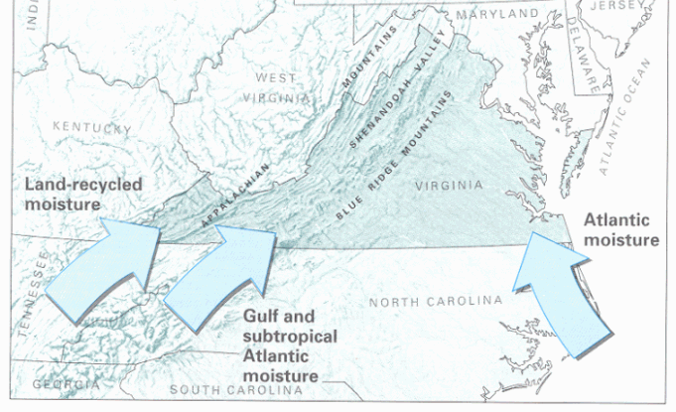
Probable maximum precipitation (PMP)
The theoretical maximum depth of precipitation (rainfall) for a given duration that is physically possible and is characteristic for a particular geographic region.
A PMP considers all related meteorological factors including intense rainfall, hurricanes, thunderstorms and the coincidence of all these meteorological factors at the same time. By definition a PMP has not occurred.

Slide 36
Probable maximum precipitation
PMP depth in area of Coles Hill, Virginia
Storm area: 10 square miles (A)
Storm duration (hours) Precipitation (inches)
6 29
12 34
24 38
48 42
72 44
For example, the PMP rainfall event that falls over a 12 hour period is 34 inches.

Slide 37
Maximum 24-Hr Rainfall Events
Location | Maximum Rainfall (inches) | Date | Available Period of Records
Chatham | 8.73 | 9/4/1996 | 1922-Present
Norfolk | 8.92 | 9/1/2006 | 1946-Present
Back Bay (Virginia Beach) | 11.20 | 9/1/1964 | 1953-Present

Slide 38
Probable maximum flood (PMF)
Is a flood calculated following the collection of a PMP rainfall event onto the ground surface and delivery to natural or constructed channels.
This flood represents the theoretical maximum flood of a given duration that could occur within a particular geographic region.
A PMF for an area must consider the drainage basin characteristics of the area. It is the most conservative design and, by definition, no PMF has occurred.

Slide 39
Conceptual regulatory framework
Requirements for environmental data EIA (cont.)
A pre-mining radiological assessment for uranium and radionuclides
A full range of baseline studies that will also include issues such as meteorology, soils, wildlife, vegetation covering the full lifecycle of the mining and milling operation

Slide 40
Conceptual regulatory framework
Water Quality
Develop detailed water quality monitoring requirements for the site
Implement extensive monitoring for uranium and radionuclides in the watershed and downstream of the uranium mining and milling sites
Evaluate the need for changes to Water Quality Standards

Slide 41
Conceptual regulatory framework
Air Quality
Develop detailed air quality monitoring requirements for the site
Implement extensive monitoring for radionuclides and particulate pollutants around uranium mining and milling sites
Evaluate taking delegation of radon and radionuclide programs from EPA

Slide 42
Conceptual regulatory framework
Water supply:
Protection of private wells from de-watering
Protection of water quality in private wells
Protection of public water supplies
Protection of agricultural water supplies

Slide 43
Conceptual regulatory framework
Transparency of Environmental Monitoring Data
Specify a data management system that allows agencies and the public timely access to environmental data collected by the facility
Establish a local community oversight committee to review and monitor environmental data from the facility

Slide 44
Conceptual regulatory framework
Requirements governing storm and process waters
From the mine
From the mill
Evaluation of effluent limitations
Evaluation of water quality criteria

Slide 45
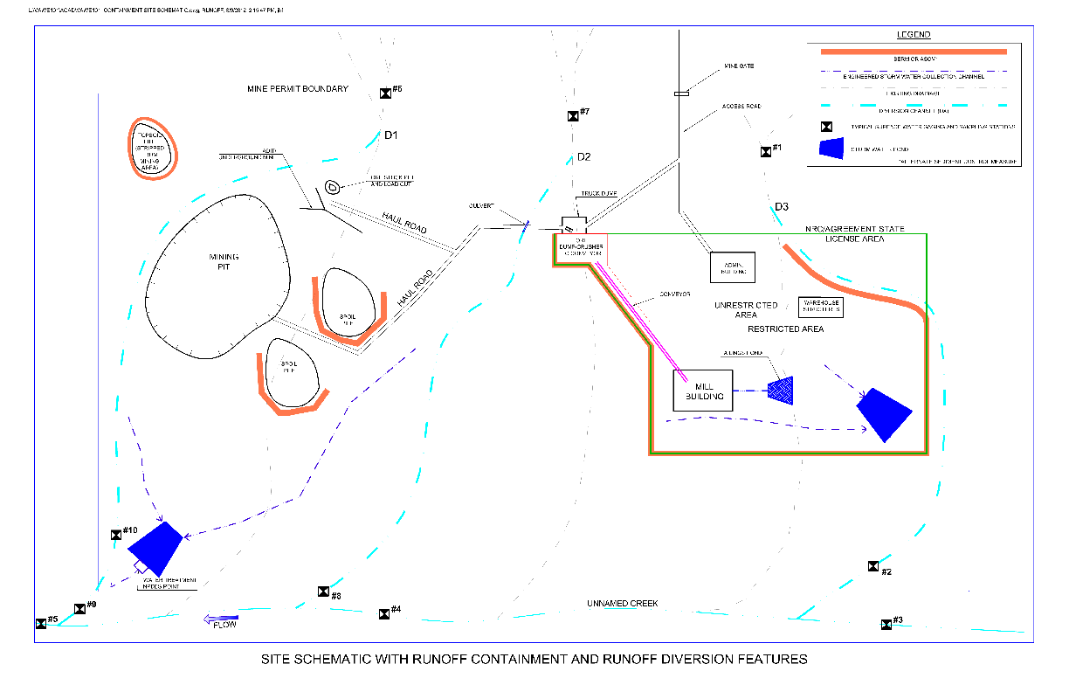

Slide 46
Conceptual regulatory framework
Tailings impoundment design criteria would need to meet or exceed NRC’s regulatory requirements. Some key considerations:
Separation from groundwater
Stability of impoundment slopes
Integrity of liner systems

Slide 47
DEQ resource needs
Expansion of water quality monitoring program for uranium and radionuclides:
FTE(s)
Additional analytical work and monitoring equipment
Expansion of air quality monitoring to cover radionuclides and particulates, and permitting and compliance for radon in the area:
FTE(s),
Additional analytical work and monitoring equipment

Slide 48
Conclusion
Prior studies have identified risk
Role of Uranium Working Group is to:
Ensure that all risks have been identified and quantified to the extent possible
Evaluate the extent to which risks can be mitigated
Propose a regulatory framework to mitigate risks
The role of the UWG is NOT to make a recommendation on the moratorium

